Slide 1
Data Science as a Career
Why?
What?
How?

Slide 2
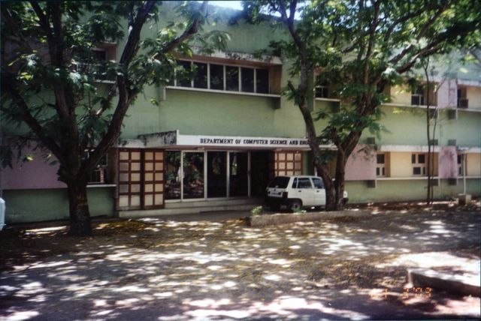
Who am I?
Abdul Majed Raja
Confession!

Slide 3


This Talk
Extremely Irrelevant
Data Science
Relevancy Scale
Extremely Relevant

Slide 4

712.4 Km
Why am I here?
80%

Slide 5
Success!
“Biologists often talk about the “ecology” of an organism: the tallest oak in the forest is the tallest not just because it grew from the hardiest acord; it is the tallest also
because no other trees blocked its sunlight, the soil around it was deep and rich, no rabbit chewed through its bark as a sapling, and no lumberjack cut it down before it matured. We all know that successful people come from hardy seeds. But do we know enough about the sunlight that warmed them, the soil in which they put down the roots, and the rabbits and lumberjacks they were lucky enough to avoid?”
Outliers, Malcolm Gladwell

Slide 6
Complaining!
“Any fool can criticize, condemn and complain - and most fools do.”
Benjamin Franklin

Slide 7
Focus!
“People think focus means saying yes to the thing you've got to focus on. But that's not what it means at all. It means saying no to the hundred other good ideas that there are. You have to pick carefully. ”
Steve Jobs

Slide 8
Divider slide heading 32pt Vodafone Bold
Hey!
Are you
going to talk about
Data Science at all????

Slide 9
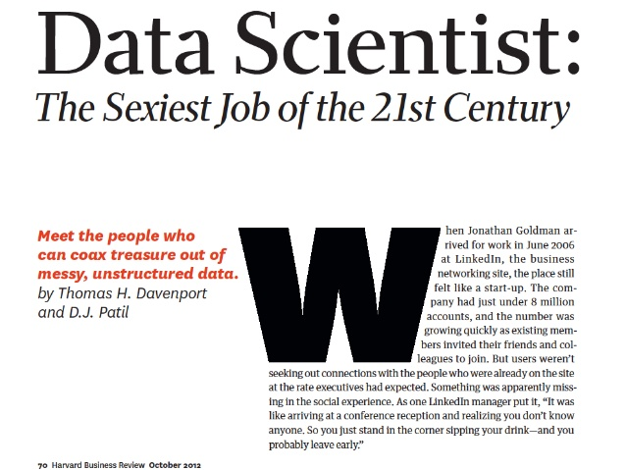
This happened!

Slide 10
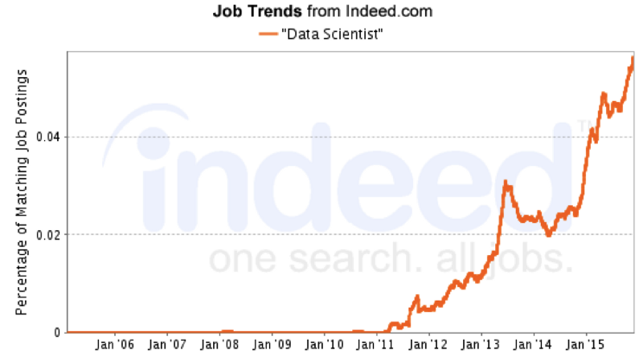
Then this happened!

Slide 11

Interested - Let’s jump in the ship!!

Slide 12
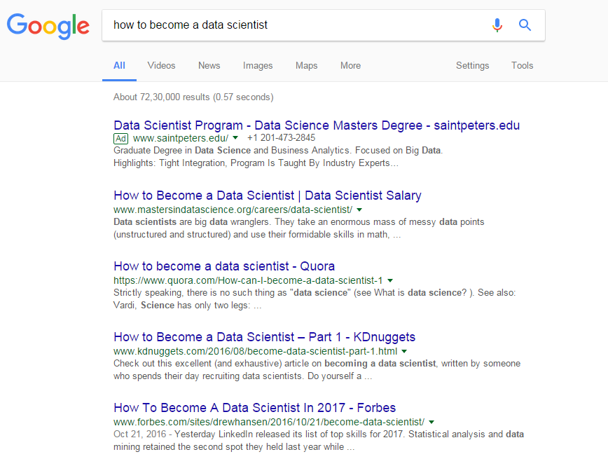
Ask Google!

Slide 13

Opinions!
Guide to become Data Scientist!
BootCamps
Paid Courses

Slide 14


The Versus Game!

Slide 15

Finally!

Slide 16
Brick Walls!
“The brick walls are there for a reason.
The brick walls are not there to keep us out.
The brick walls are there to give us a chance to show how badly we want something.
Because the brick walls are there to stop the people who don’t want it badly enough. They’re there to stop the other people.”
The Last Lecture , Randy Pausch

Slide 17
Divider slide heading 32pt Vodafone Bold
Introduction
to
Data Science!

Slide 18
Data Science – Synonyms
Machine Learning
Data Mining
Advanced Analytics
Data Analytics
Business Analytics
Artificial Intelligence
Deep Learning

Slide 19

find.what(‘Data Science’)
http://drewconway.com/

Slide 20
Hacking:
To play with Data :
Data Collection – Web Scraping
Data Cleaning & Processing
Code Optimization
Model Deployment

Slide 21
Math & Statistics:
Understanding Statistics, Probability, Econometrics:
What Machine learning Technique to use?
How to evaluate and validate different modeling strategies?
How to design Randomized Experiments?

Slide 22
Substance:
Business / Domain/ Market Knowledge :
How to help business ask the right analytics question?
How to present the outcome of the analysis?
How to estimate the value?

Slide 23
Divider slide heading 32pt Vodafone Bold
Data Science
Workflow

Slide 24

Data Science - Scenario #1:

Slide 25
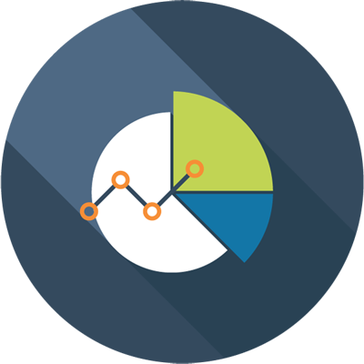





Data Science – Scenario #2
4
Data Visualization
3
Data Manipulation
2
Data Cleaning
1
Data Collection

Slide 26
Divider slide heading 32pt Vodafone Bold
“Analysis is Worthless
if you don’t
Communicate it”

Slide 27
Communication
State | 2001 | 2011
Andhra Pradesh | 978 | 992
Arunachal Pradesh | 893 | 920
Assam | 935 | 954
Bihar | 919 | 916
Chhattisgarh | 989 | 991
Goa | 961 | 968
Gujarat | 920 | 918
Haryana | 861 | 877
Himachal Pradesh | 968 | 974
Jammu & Kashmir | 892 | 883
Jharkhand | 941 | 947
Karnataka | 965 | 968
Kerala | 1058 | 1084
Madhya Pradesh | 919 | 930
State | 2001 | 2011
Maharashtra | 922 | 925
Manipur | 978 | 987
Meghalaya | 972 | 986
Mizoram | 935 | 975
Nagaland | 900 | 931
Odisha | 972 | 978
Punjab | 876 | 893
Rajasthan | 921 | 926
Sikkim | 875 | 889
Tamil Nadu | 987 | 995
Tripura | 948 | 961
Uttar Pradesh | 898 | 908
Uttarakhand | 962 | 963
West Bengal | 934 | 947
NITI Aayog: Sex Ratio (Females/ 1000 Males)

Slide 28
Data Visualization

Slide 29
Divider slide heading 32pt Vodafone Bold
Minimalistic
Learning
Path

Slide 30
Complete Newbie
Pick a Language — R /Python
Basics of the language — Data Types, Loops, Conditions, Functions
Beginning of Data Analysis
Data Visualization
Machine Learning begins - Statisics
Machine Learning Rises – Building Models
Entry-Level Data Scientist

Slide 31
Complete Newbie
Find a Mentor (online or offline)
Prepare with a group/team or at least a partner
Don’t waste a single paisa for courses (except Internet charges cost)
Attend Meetups and Conferences
Read, Listen, Read, Read – Blogs, Podcasts, Whitepapers, Books
Entry-Level Data Scientist

Slide 32


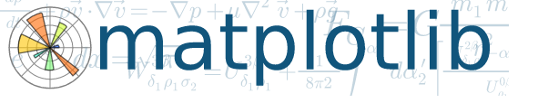



Py
Data Science

Slide 33
Produce!
“If you don’t produce, you won’t thrive—no matter how skilled or talented you are.”
Deep Work, Cal Newport

Slide 34
Showcase!
Github – Own Repos, Contributions
Competitions/Hackathons – Kaggle, Crowdanalytix, Analytics Vidhya Hackathon
Blog posts – Medium, Wordpress, Github
Meetups/Conferences

Slide 35



Get in Touch!
@amrrs
@amrwrites
amr.rs.contact@gmail.com

Slide 36
Thanks!

